Slide 1

Final Report Presentation
IBM Data SCIENCE Professional cetification

Slide 2
Capstone Project – The Battle of Neighborhoods Finding a Better Place in Scarborough, Toronto
The purpose of this Project is to help people in exploring better facilities around their neighborhood. It will help people making smart and efficient decision on selecting great neighborhood out of numbers of other neighborhoods in Scarborough, Toranto.
This Project aim to create an analysis of features for a people migrating to Scarborough to search a best neighborhood as a comparative analysis between neighborhoods. The features include median housing price and better school according to ratings, crime rates of that particular area, road connectivity, weather conditions, good management for emergency, water resources both freash and waste water and excrement conveyed in sewers and recreational facilities.
It will help people to get awareness of the area and neighborhood before moving to a new city, state, country or place for their work or to start a new fresh life.

Slide 3
Data Foursquare API Data:
Foursquare is a location data provider with information about all manner of venues and events within an area of interest.
Such information includes venue names, locations, menus and even photos
Data about different venues in different neighborhoods of specific borough. Such a;
Neighborhood Latitude & Longitude, Venue Latitude & Longitude
Data Link: https://en.wikipedia.org/wiki/List_of_postal_codes_of_Canada:_M

Slide 4

Map of Scarborough

Slide 5
Methodology Section Clustering Approach:
The objective is to compare the similarities of cities, thus we decided to explore neighborhoods; - Segments, and - Grouped Clusters
To be able to do that, we need to cluster data which is a form of unsupervised machine learning: k-means clustering algorithm
K-Means Clustering Approach was the preferred methodology

Slide 6
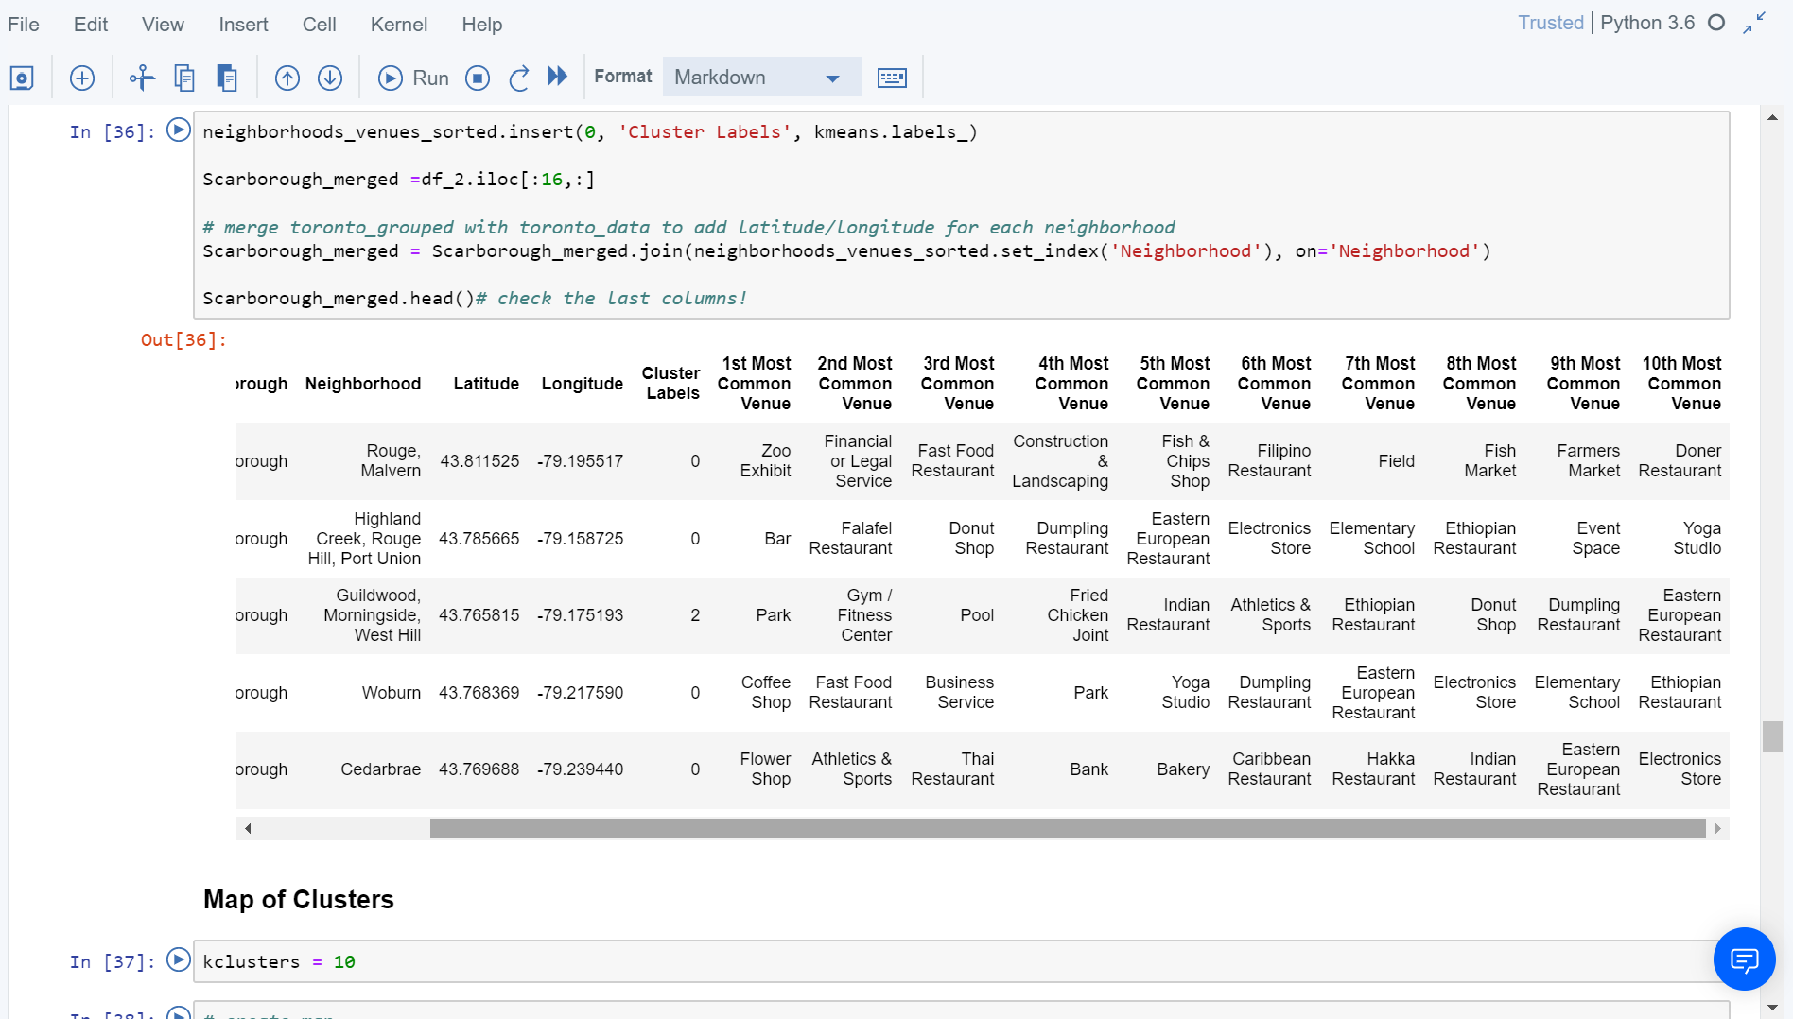
Clusters of Map

Slide 7
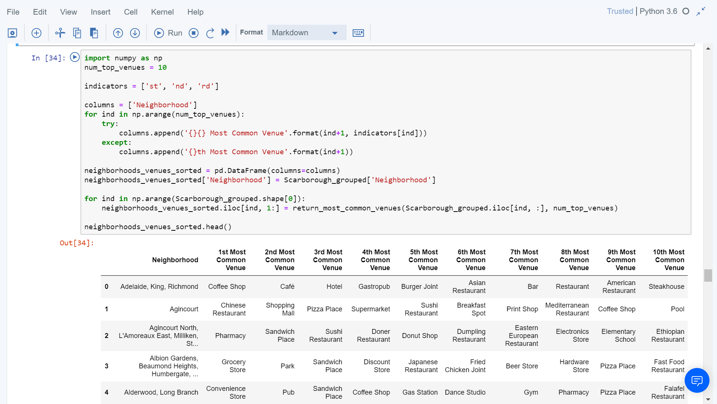
Most Common venues near Neighborhood
Neighborhood,
Neighborhood Latitude,
Neighborhood Latitude,
Venue,
Name of the venue,
Venue Latitude,
Venue Longitude, and
Venue Category

Slide 8

Results Map of Clusters in Scarborough

Slide 9
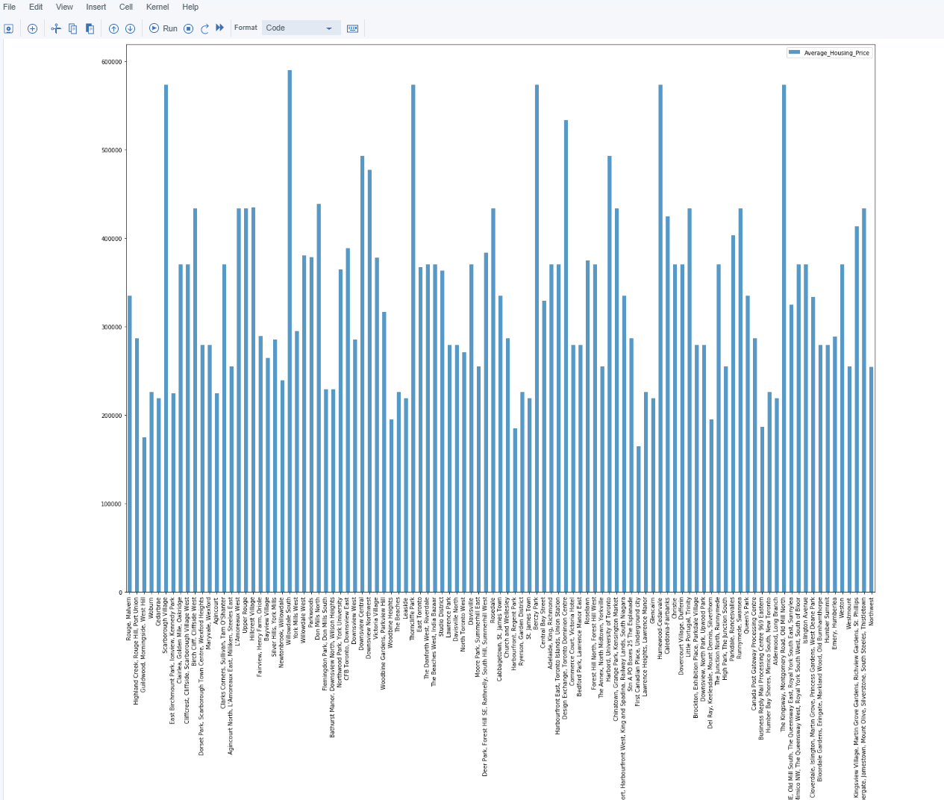
Results Average Housing Price by Clusters in Scarborough

Slide 10
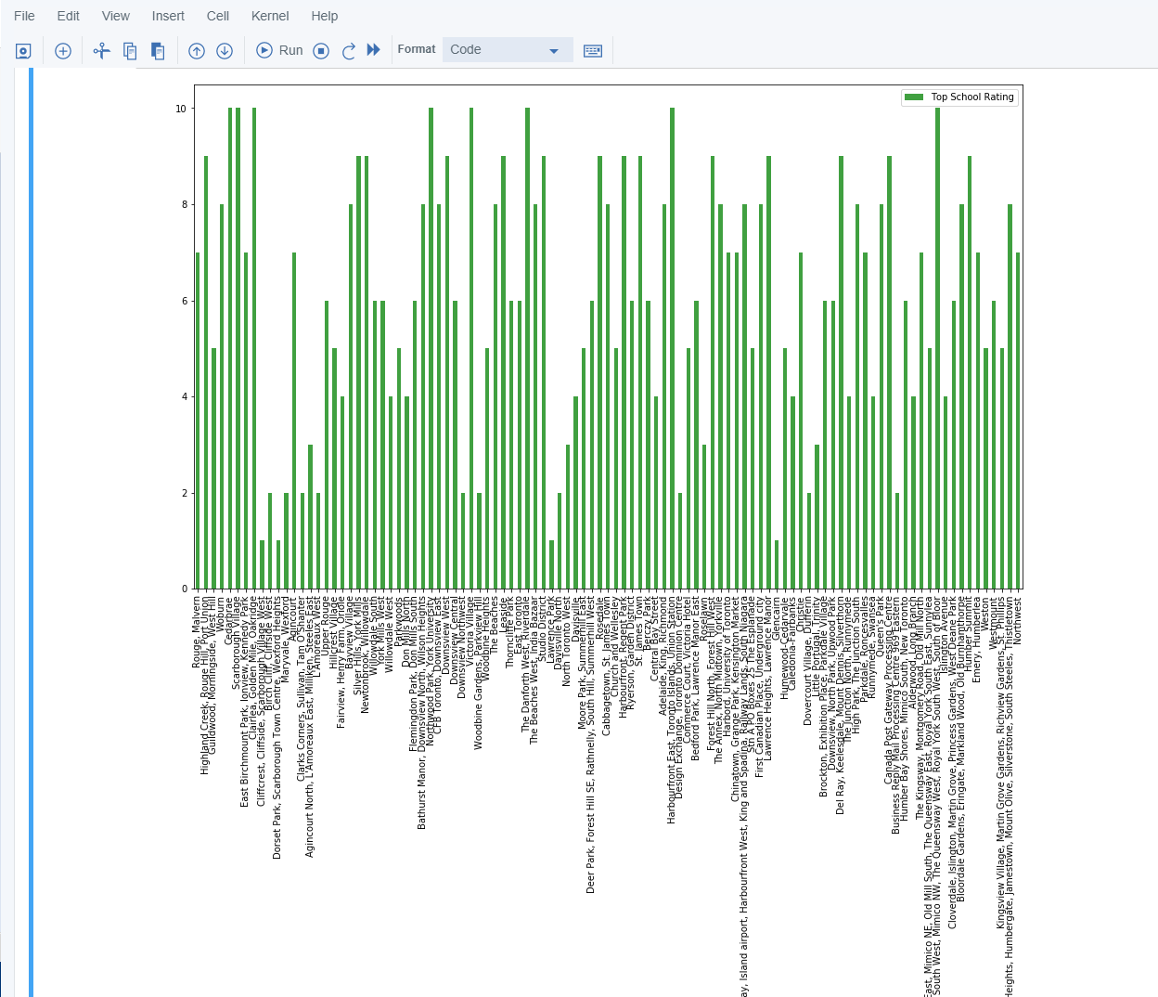
Results School Ratings by Clusters in Scarborough

Slide 11
Discussion Problem Which we are Solving for:
Problem Statement: Are there better neighborhoods in a new city for a person who is relocating?
Social presence in society in terms of like minded people. Connectivity to the airport, bus stand, city center, markets and other daily needs things nearby.
Sorted list of house in terms of housing prices in a ascending or descending order
Sorted list of schools in terms of location, fees, rating and reviews

Slide 12
Conclusion
The K-Means Algorithm
Separated the neighborhood into 10(Ten) different clusters and for 103 different lattitude and logitude from dataset.
Which have very-similar neighborhoods around them.
Using the charts above results presented to a particular neighborhood based on average house prices and school rating have been made.
This project has provided a practical application to resolving situation that have a personal and financial impact using Data Science tools Sorted list of schools in terms of location, fees, rating and reviews.
The mapping with Folium is a very powerful technique to consolidate information and make the analysis and decision better with confidence.
Future Works
This project can be continued for making it more precise in terms to find best house in Scarborough. Best means on the basis of all required things(daily needs or things we need to live a better life) around and also in terms of cost effective.

